Slide 1
Shuttle Court Arrangement
contents
Introduction
Shuttle pitch
Pitch design
Fencing design
Surrounding water flow
Lighting for night
Play ground matt
Sitting area
Washroom design
Cafeteria design

Slide 2
Introduction
Shuttle is a racket sport played using rackets to hit a shuttlecock across a net
Although it may be played with larger teams, the most common forms of the game are "singles" (with one player per side) and "doubles" (with two players per side).
Shuttle is often played as a casual outdoor activity.
Formal games are played on a rectangular indoor court.

Slide 3
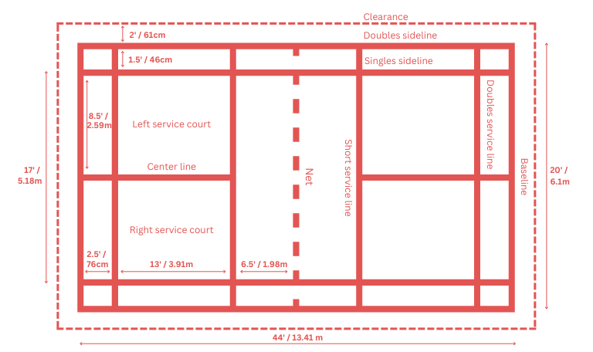
Court design: Shuttle pitch 1.Shuttle pitch measurements:

Slide 4
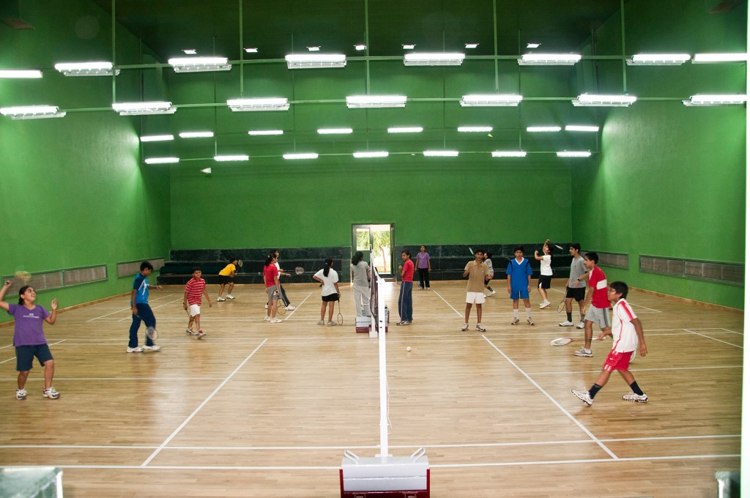
2.Type of Shuttle pitches
They are two types of pitches
Indoor shuttle pitch
Outdoor shuttle pitch

Slide 5
Measurements:
Court | Singles | Double
Length | 13.40m | 13.40m
Width | 5.18m | 6.10m
Short service line | 1.98m | 1.98m
Long service line | 6.70m | 5.94m
Lines thickness | 4cm | 4cm

Slide 6
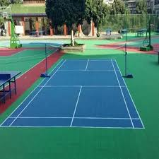
Outdoor shuttle pitch

Slide 7
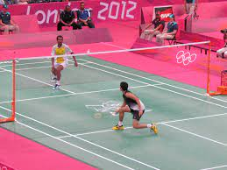
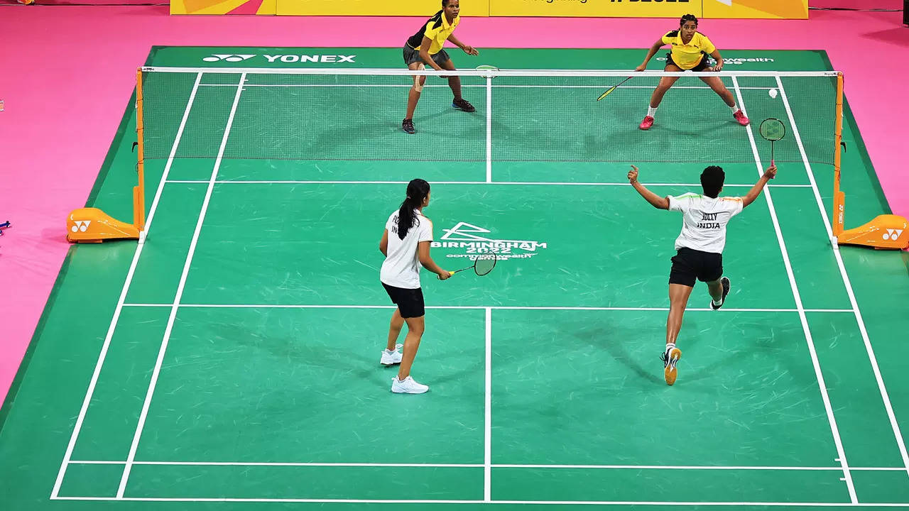
3.Single and double play shuttle court 1.single play 2.Doble play shuttle shuttle court court

Slide 8
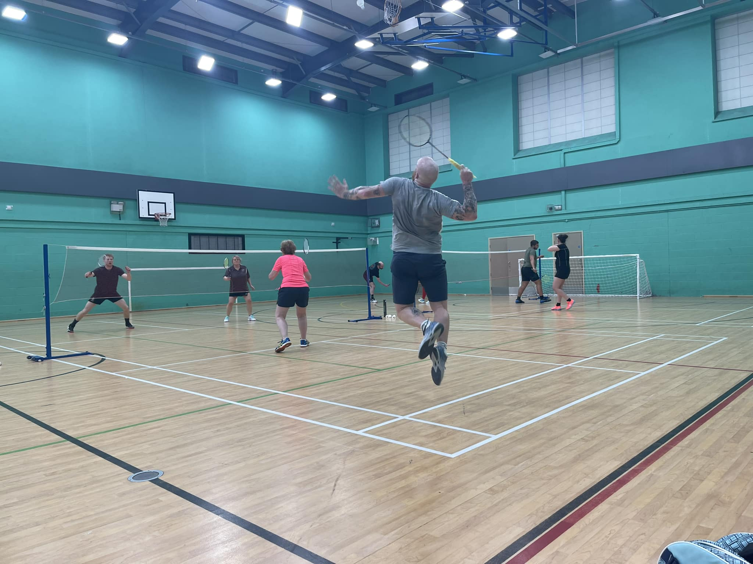
4.Mixed play shuttle court:

Slide 9
Pitch design: 1. we have 26 sq ft*50 sq ft total area:(1300 squar feet) 2.we need for court(880 square feet)

Slide 10
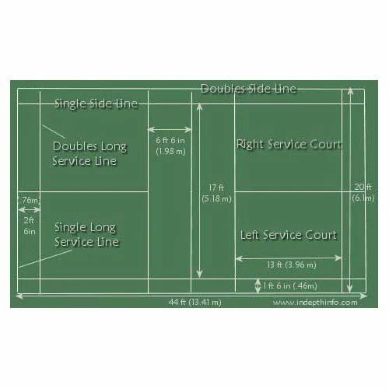
2.Singles and Double play shuttle court: 880tyrerertertreteterewrewrwwewe
Total area 880 square feet

Slide 11
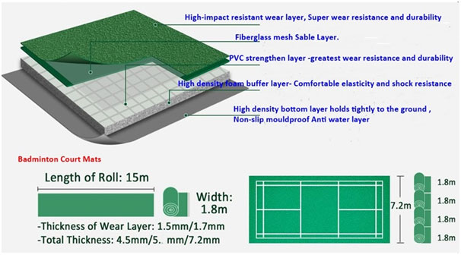
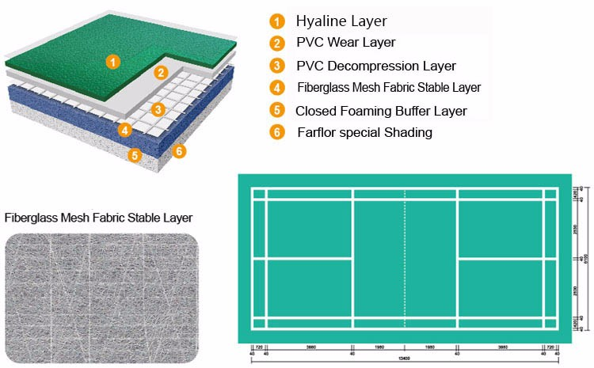
2.Floor sand and floor material matt arrangement 1.Floor sand 2. Floor material

Slide 12
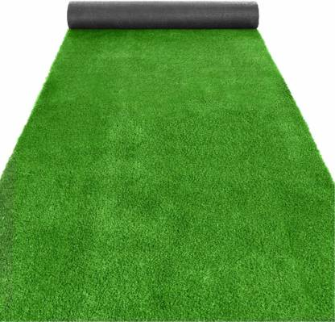
Floor grass:

Slide 13
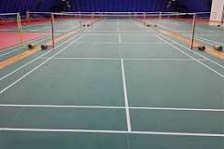
Floor matt material: There are different types of badminton courts flooring. The four most common floorings used are wooden, vinyl, rubber, and pp interlock tiles.
Vinyl flooring is ideal for badminton courts because of its water-resistance properties. This type of flooring comes in different colors and designs that mimic other materials such as wood or stone. As a result, you can use vinyl to simulate a wooden court.
80 to 300/- per sqr foot
These all used on the wooden flooring
It provides different colours and designs
These are widely used flooring material

Slide 14
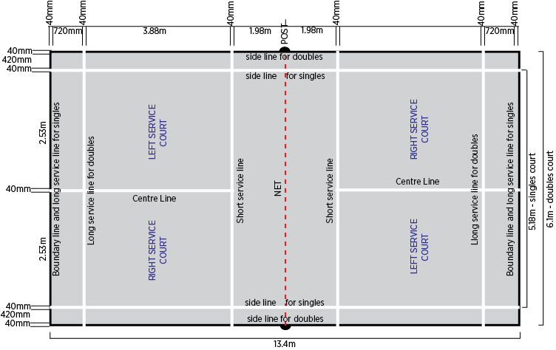
3.Floor marker: (1,620 square feet)

Slide 15
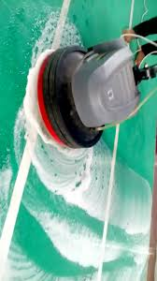
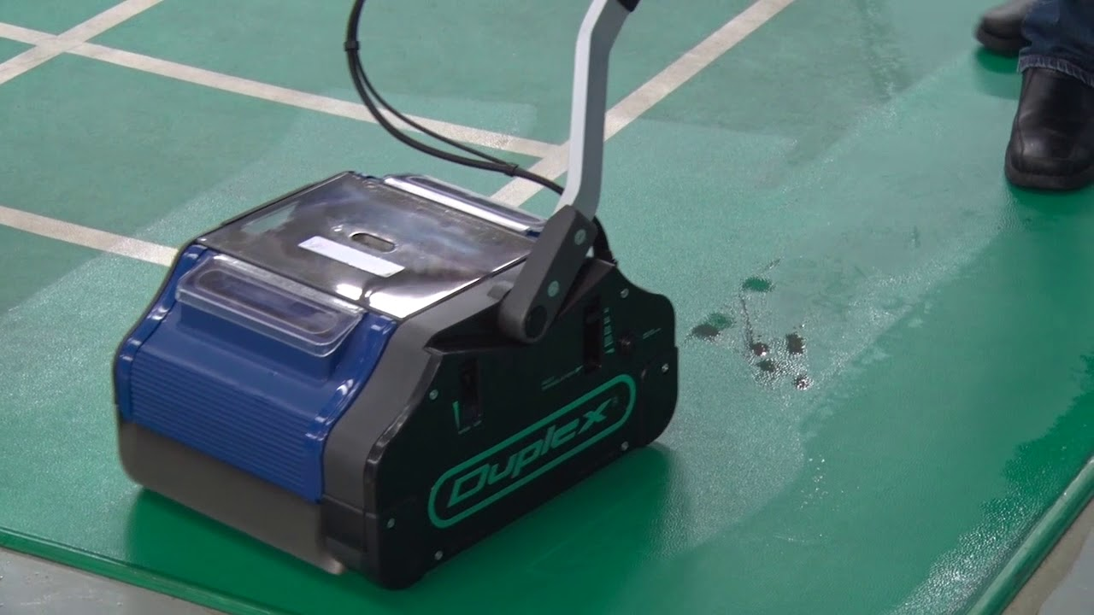
Floor cleanups equipments : These are starts from (23000 to 200000 /-)
1.Singledisk floor 2.scrubber machine
3.Carpet cleaner

Slide 16
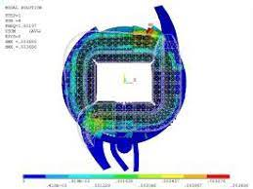
Surrounding water flow:

Slide 17
Surrounding water flow:
15000
20000
25000
10000

Slide 18
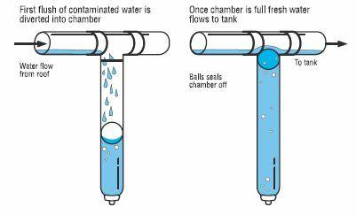
Rain water flash:
First Flush or Rain Diverters, as the name implies, flush off the first water of a storm before it enters the storage tank. This is the water that could be the most contaminated by particulates, bird droppings, and other materials laying on the roof.

Slide 19
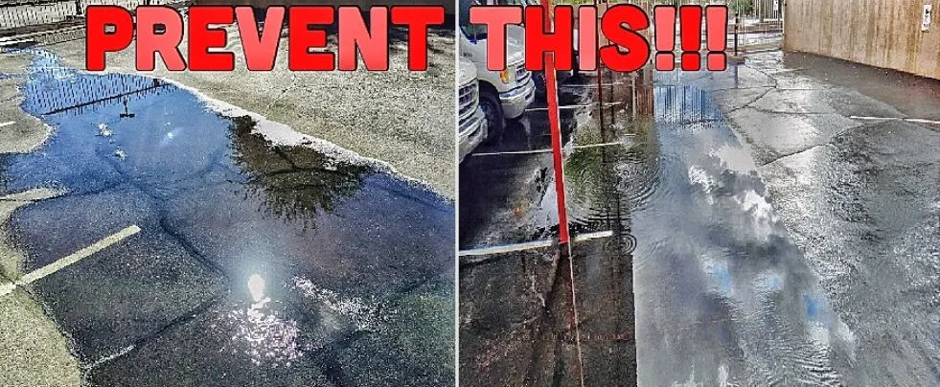
Water Flow Fixes: Concrete Flowlines/Swales:

Slide 20
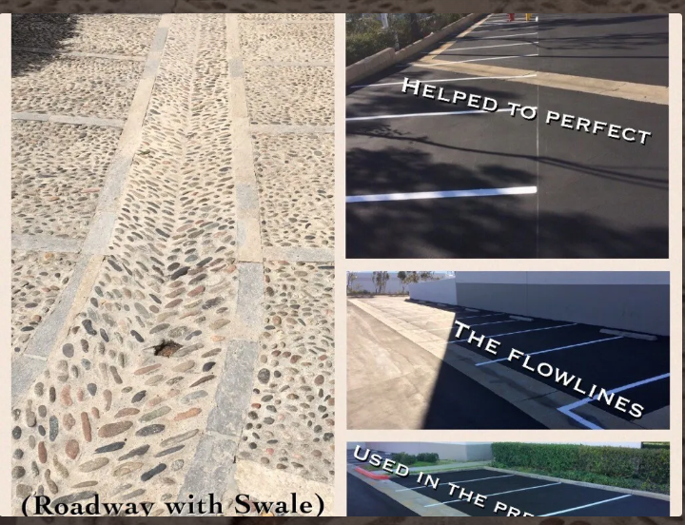

Slide 21
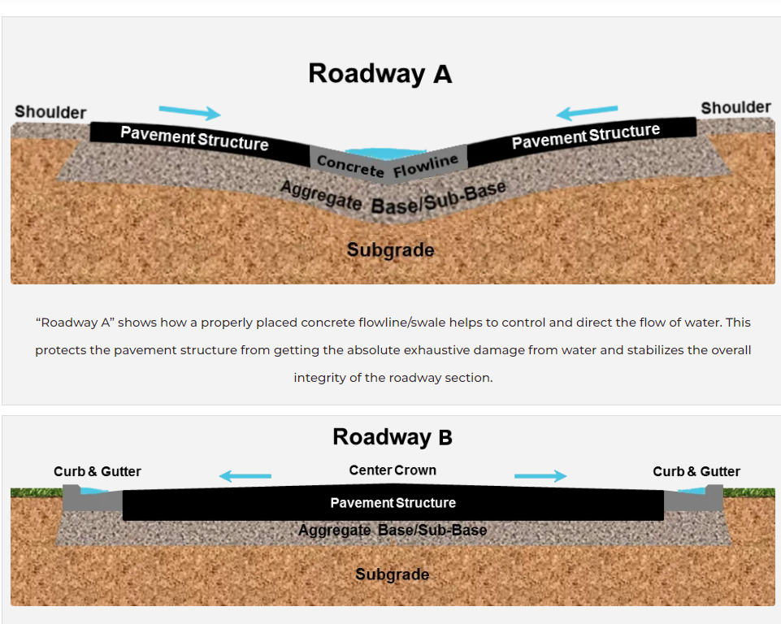
A swale is designed to collect rainwater on your property and the only way to do this without a pump is by gravity flow. Therefore, a swale collects the water by being the lowest point in a given area and then is pitched to wherever you want the water to go. When we say pitched, we mean the ground is sloped to allow the water to roll downhill within the swale.

Slide 22
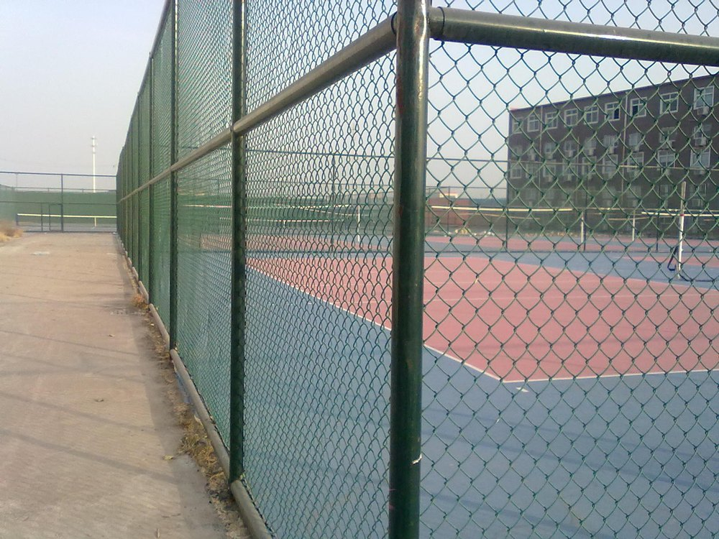
Fencing design:
Types of poles
1.Metal pole(150 to 500 per kg)
2.Stone pole(250 per feet)
3.Cement pole(100 to 500 [per pole])

Slide 23
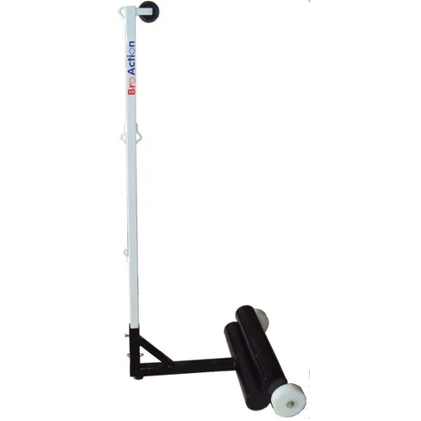
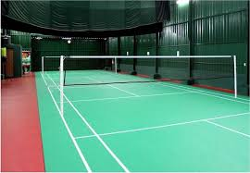
2. No. of polls 3.Position of polls

Slide 24
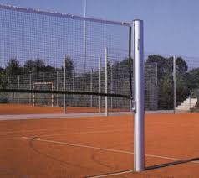
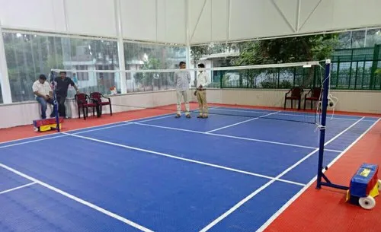
Type of poles :They are two type of poles i. fixed poles ii. movable poles

Slide 25
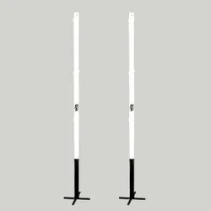
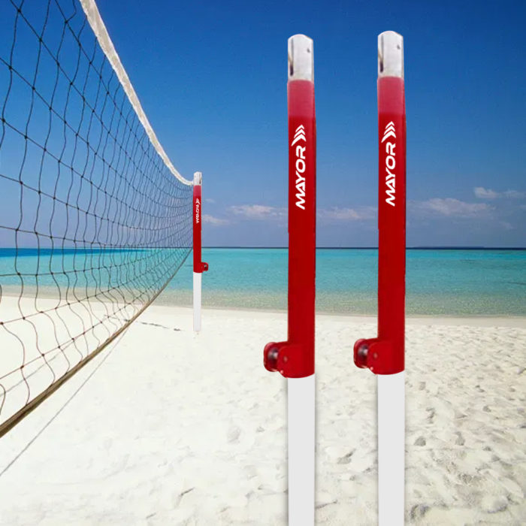
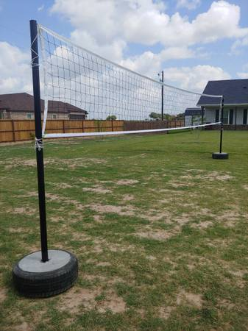
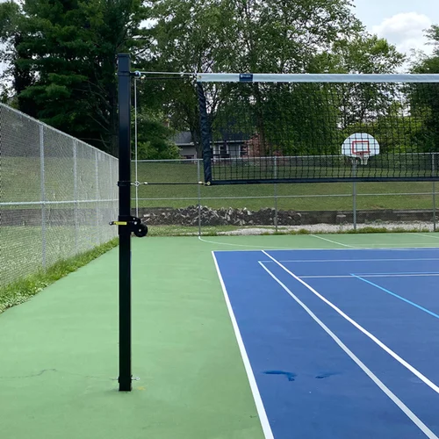
Fixed pole types:

Slide 26
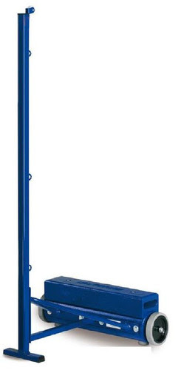
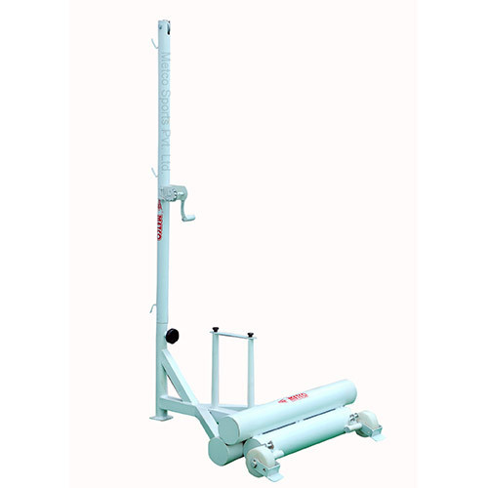
Movable pole types:

Slide 27
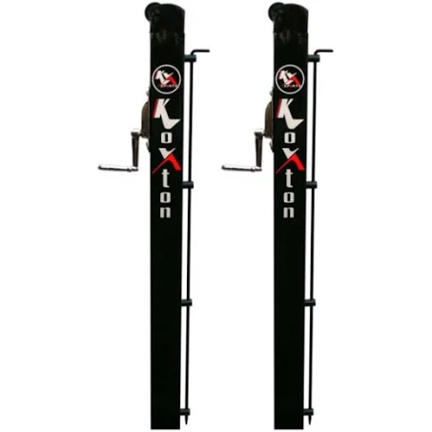
Fixed pole: ( 5000 to 40000)

Slide 28
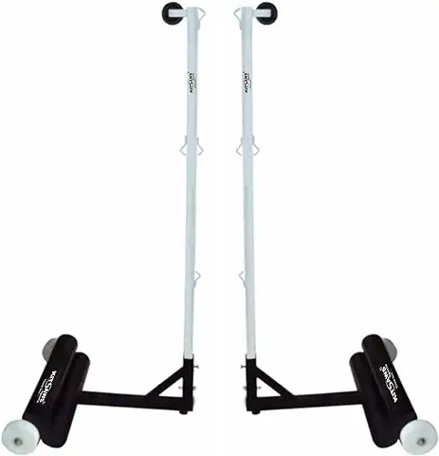
Movable pole: (3000 to 20000)

Slide 29
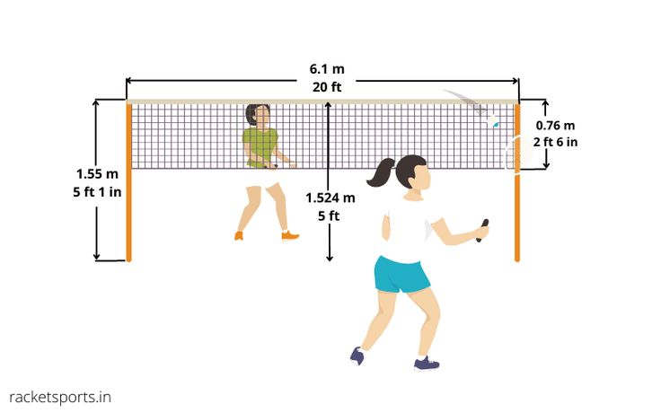
4.Types of net 1.polyethylene 2.nylon 3. vinyl.
5. Position of nets & Length of nets

Slide 30
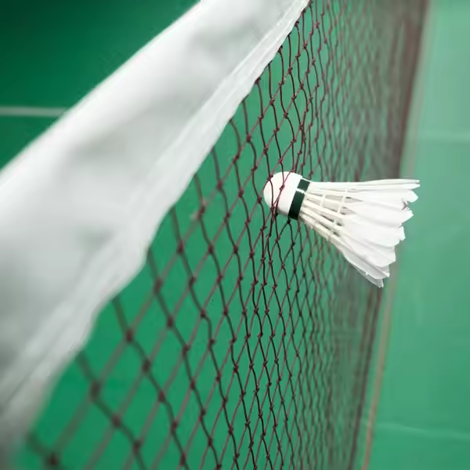
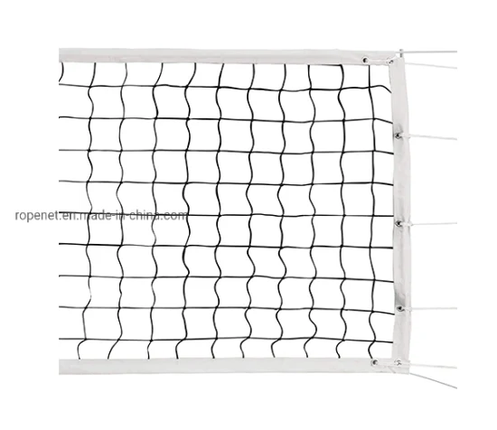
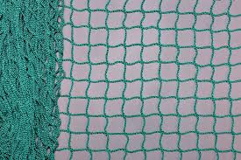
polyethylene
nylon
vinyl.

Slide 31
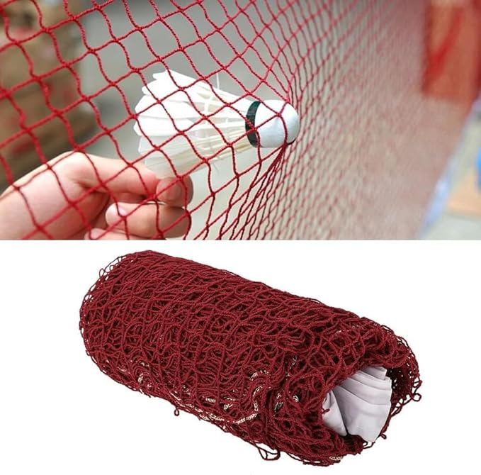
Badminton Net: Nylon net is best
325 to 200

Slide 32
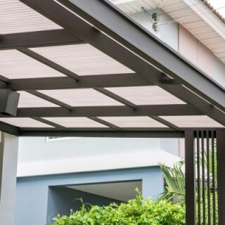
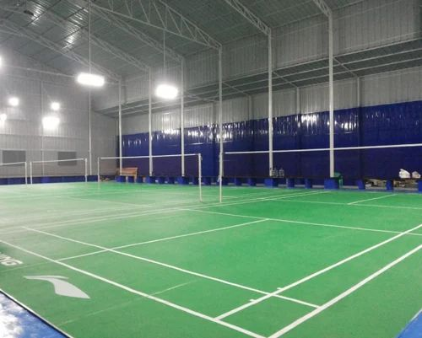
6.Top roof for rain season I. Plastic roofing II . Aluminum sheet design coated roof shed

Slide 33
Aluminum coated roof shed:
1) Environment-Friendly. Traditional asphalt shingles conduct more heat than their aluminium roll sheet counterparts.
2) Expense but having long life of 40 to
60 years
3) Sturdy.
4) Extremely lightweight metal. ...
5) Simple to instal.
6) Substantial Worth as Scrap.
7) Non-corrosive.
8) Flexibility.

Slide 34
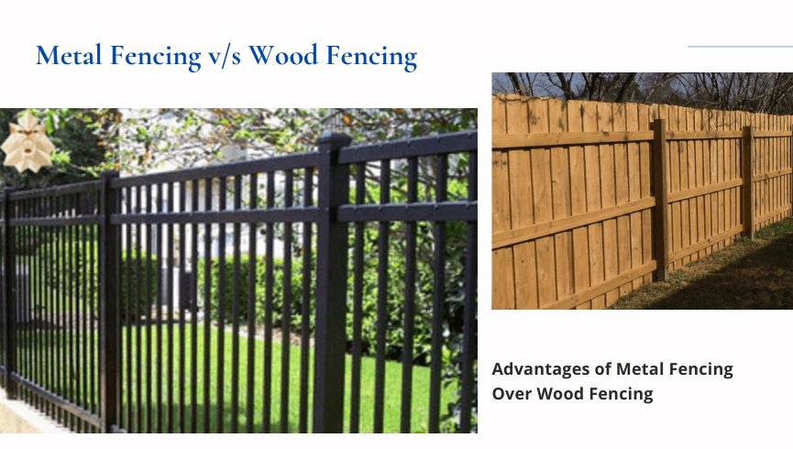
7.Cover items: They are two types i. Metal fencing(cost `138 to 300` per kg) ii. Wooden fencing (cost `180 per sqr ft)

Slide 35
Metal fencing: The metal fencing is mainly used as fencing material for all sports stadiums.
1. Availability: In comparison to wood, metal fencing is easily available and has easy installation. In recent times, metal fencing fabrication is being done with the aim of customer satisfaction and ease of use.
2. Longevity or Durability: It goes without saying that wood does not have long life, it requires a lot of maintenance and care to ensure protection from pests and the elements.
3. Security: Iron fencing definitely wins over wooden fencing when it comes to security. Metal fencing would require an intruder to come equipped with big machinery to break in.
4. Strength: Another very important aspect of metal fencing whether steel or iron is, it is stronger than wood. Elements like severe weather conditions, pests or intruders cannot influence them as in case of wooden fencing, which needs to be replaced completely if attacked or damaged by any of these.
5. Cost: It depends on the intention of the owner of a property. If one is looking for long-term cost-effective investment, then metal is a thoughtful choice but for short term investment, one can go for wood. Wood has easy wear and tear and requires a lot of maintenance like occasional painting, termite treatment and others whereas with metal fencing, there’s only one-time investment and maintenance is also too frequent.
6. Appearance: Wood adds richness to a property .Even with all its drawbacks, it wins hands down when compared to metal. But, with Ornamental Steel Fabrication Services NY, this has also been taken care off. We have too many options available for metal fencing and in different types of material as iron and steel
7. Biodegradable: Yes, wood fence is environment friendly and biodegradable unlike metal fences. But, when one takes a closer view, it is harsh on the environment as a lot of trees has to be cut for building a wooden fence, so nullifies its biodegradable in the long run. With metal fencing, if there’s a wear and tear, it can be repaired and can stand a longer period of time.
8. Installation: Wood fencing has easy installation, but it does not have a very strong hold on the ground. With new methodology used in fencing fabrication New York, metal fencing comes with ready to install panel, and is quite convenient to use. Further, they are firm and has good hold in the ground.
9. Design Options: Both wood and metal fencing have design options. However, with metal there are no limits and can be moulded and framed in a manner that one has imagined, with wood there’s a limitation and might require a lot of wood logs for craving out the desired design.
10. Dealers and Retailers: With market options growing for metal fencing, online professional dealers are available for metal fencing which gives virtual and offline consultation and makes work easier. Dealers are decreasing in number for wooden fencing as wood is becoming scarce and rare.

Slide 36
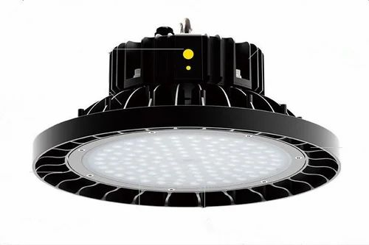
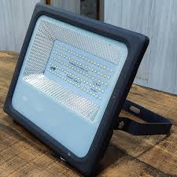
Lighting for Night 1. Types of lights: The walls of the badminton court must be dark. There are two forms of lighting that can be integrated into the lighting design and environment: led high bay lights and led floodlights. Light levels should be between 400 and 500 lux. The lights, on the other hand, are placed parallel to the sideline.

Slide 37
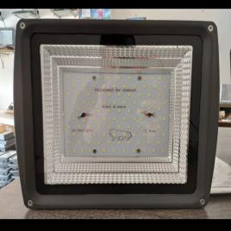
1050/-

Slide 38
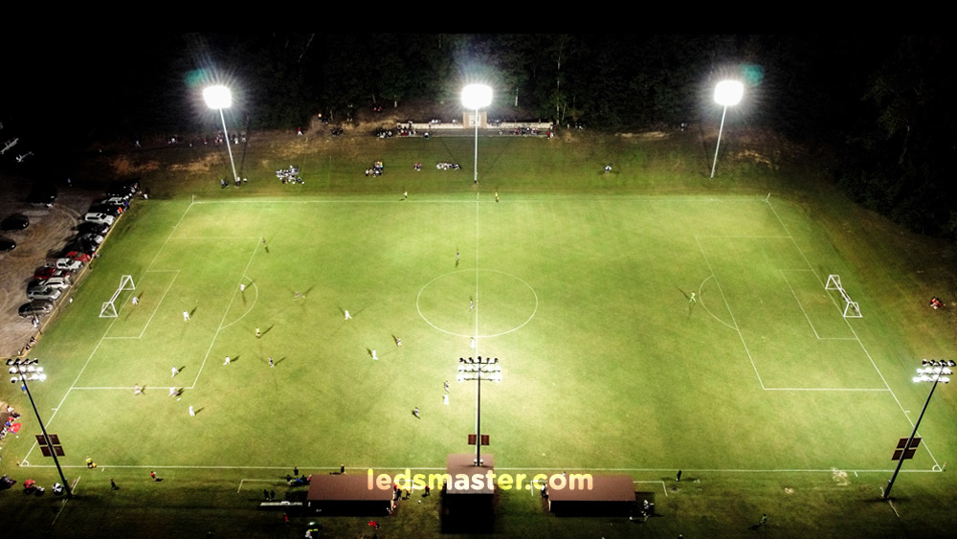
Number of lights: 10 to 15 lights are needed for total stadium

Slide 39
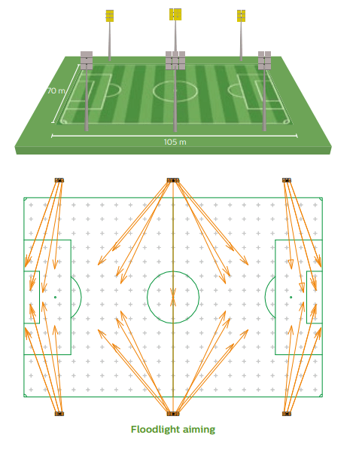
Position of the lights:

Slide 40
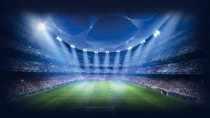
Focus of the light: In stadium, the focus of the is Towards the ground of the court.

Slide 41
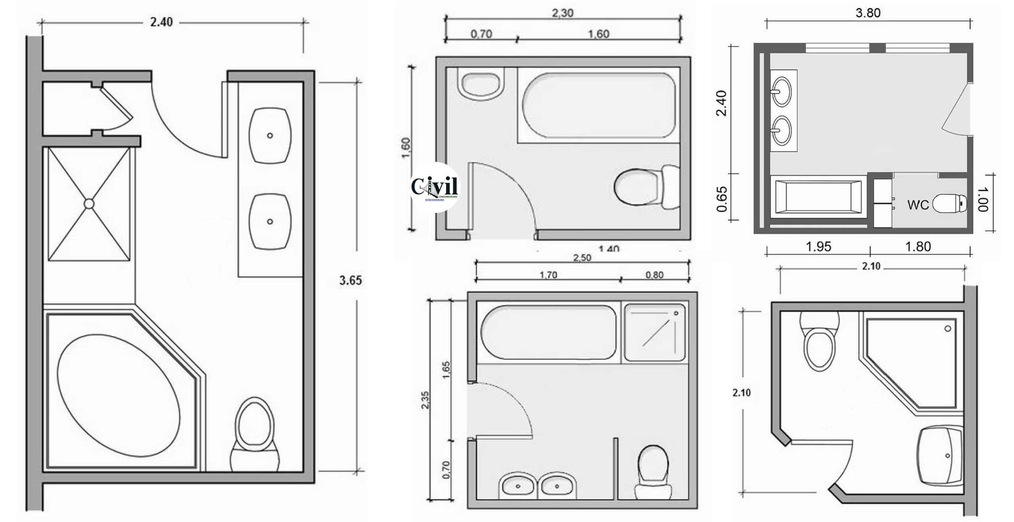
Types of washroom designs:

Slide 42
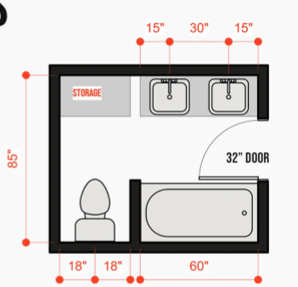
Washroom: 1. Measurements(8*5=40 square feets)

Slide 43
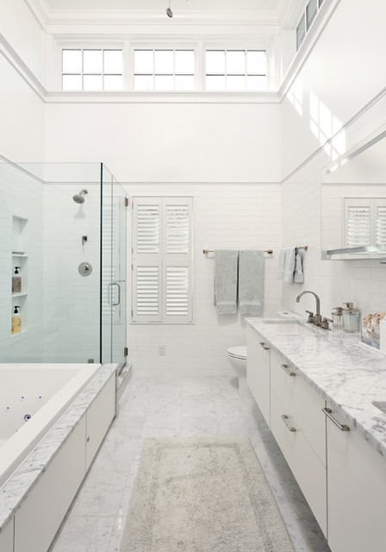
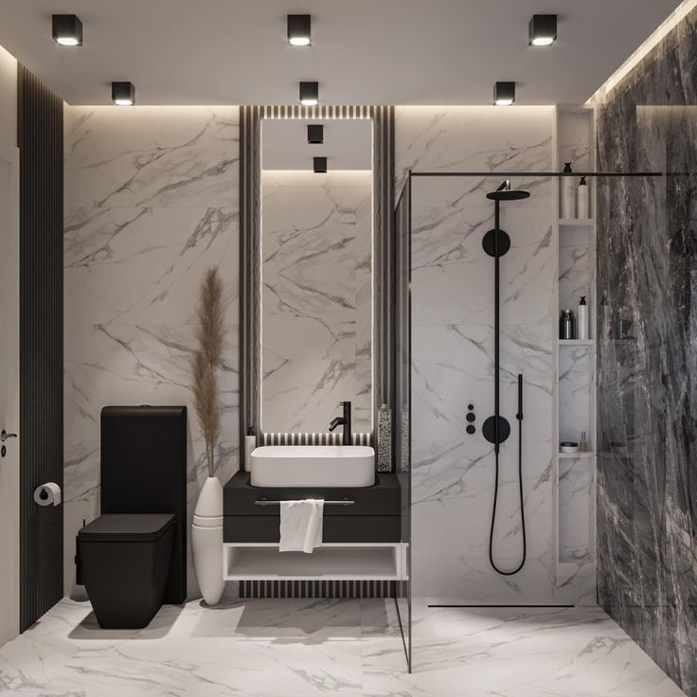
Type of wash rooms:

Slide 44

Washing equipment:

Slide 45

Types of chairs
StadiumPush Back Red Plastic Chairs.
Plastic Auto Tip Up Stadium Chair Without Arms.
Crystal Fibre Stadium Floor Mounted Seating.
Leather Manual Luxury Recliner Chair.
Red Sotase Stadium Chair Indoor Outdoor
Auditoriums Auditorium Tip Up Chairs.

Slide 46
3000
25000
5000
11000

Slide 47

Types of Tables:

Slide 48




Prices of the tables: (3000 to 90000)

Slide 49




Types of Resting areas:

Slide 50


Equipment used for resting area:

Slide 51

Sitting area: It need 10 square feets per person so, for 7 people 70 square feets

Slide 52

Types of chair arrangements:

Slide 53


Slide 54


Out door sitting:

Slide 56
In door sitting:

Slide 57

Cafeteria plan: ( Total area 154 square feet)

Slide 58


Cafeteria equipment:

Slide 59
Cafeteria design: ( 10000 to 200000/-)

Slide 60
Required place: available place 13000 square feets
Double shuttle court :
880 square feets
For washroom design :
size 8*5 (40 square feet)
Cafeteria :
Table Per person (12 square feet)
Chair per person(10 square feet)
Per person 22
7*22=154
Sitting area :
Per person(10 square feet)
7*10=70

Slide 61
Total place: Total place we have 16*50 sqrt 1300 square feet
880+40+154+70=1144=1300-1144=156 square feet(remaining)

